Slide 1
Sorority and Fraternity Management System
Jennifer Barry
Meredith Weiner
Advisor: Professor Femister

Slide 2
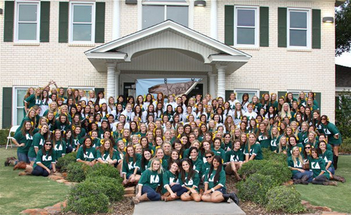
Client

Slide 3
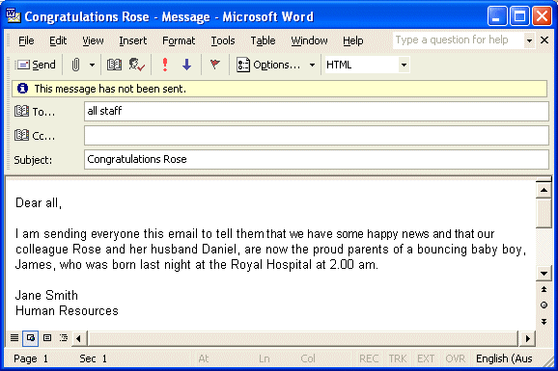
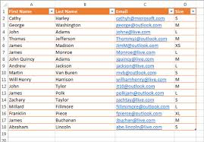
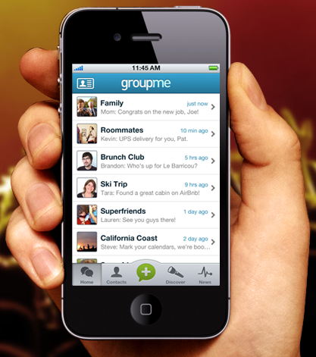
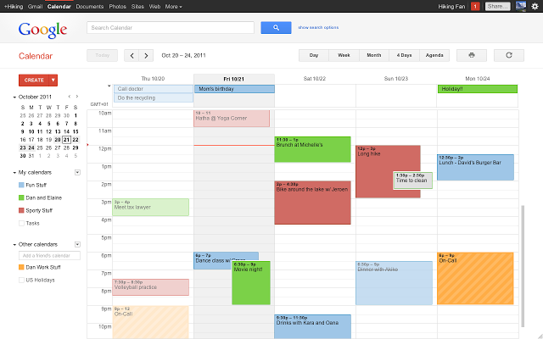
Problem

Slide 4





Our solution

Slide 5
Why is this important?

Slide 6
Customer Requirements
Phase 1
Each chapter can subscribe to this service
Profile page for each member
Role based access rights
Event information and signup system
Phase 2
Links to each social media site
Roster with contact information and positions
Menu for the week, as per the chef
Keeping track of event attendance based on signups

Slide 7
Implementation
Phase 1
Each chapter can subscribe to this service
Profile page for each member
Role based access rights
Event information and signup system

